Slide 1



Unit 0: Introduction
Lesson C: Vocabulary

Slide 2

EXERCISE 1
Look at the photos
Match them with the names
What films do they appear in?
Do you know who the actors are?
www.phuongnam.edu.vn

Slide 3
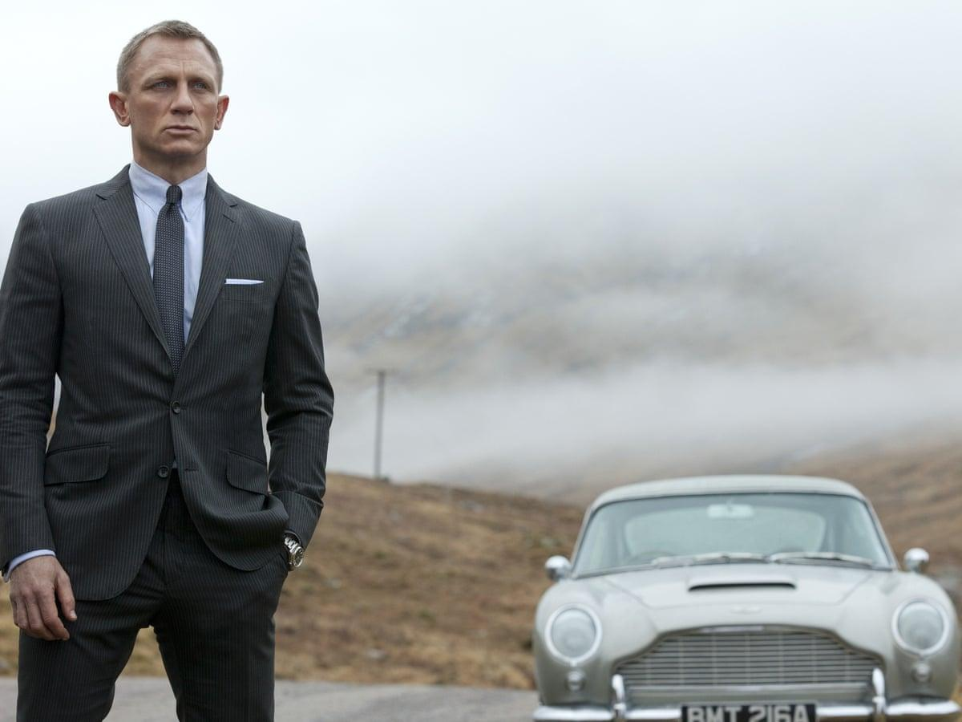
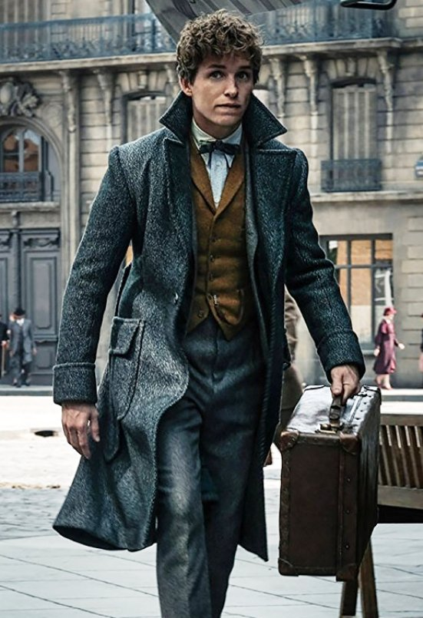
James Bond
Black Widow
Newt Scamander
Actor: Daniel Craig
Actor: Eddie Redmayne
Maleficent
Katniss Everdeen
Film: The James Bond films
Film: Fantastic and Where to Find Them
www.phuongnam.edu.vn

Slide 4
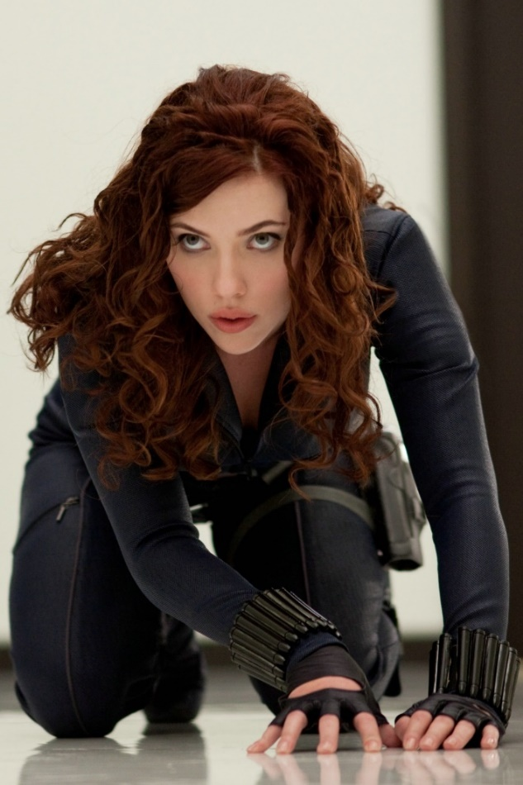
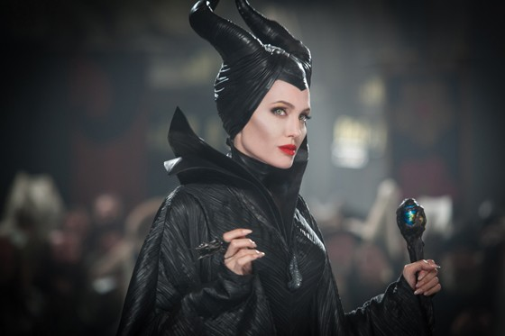
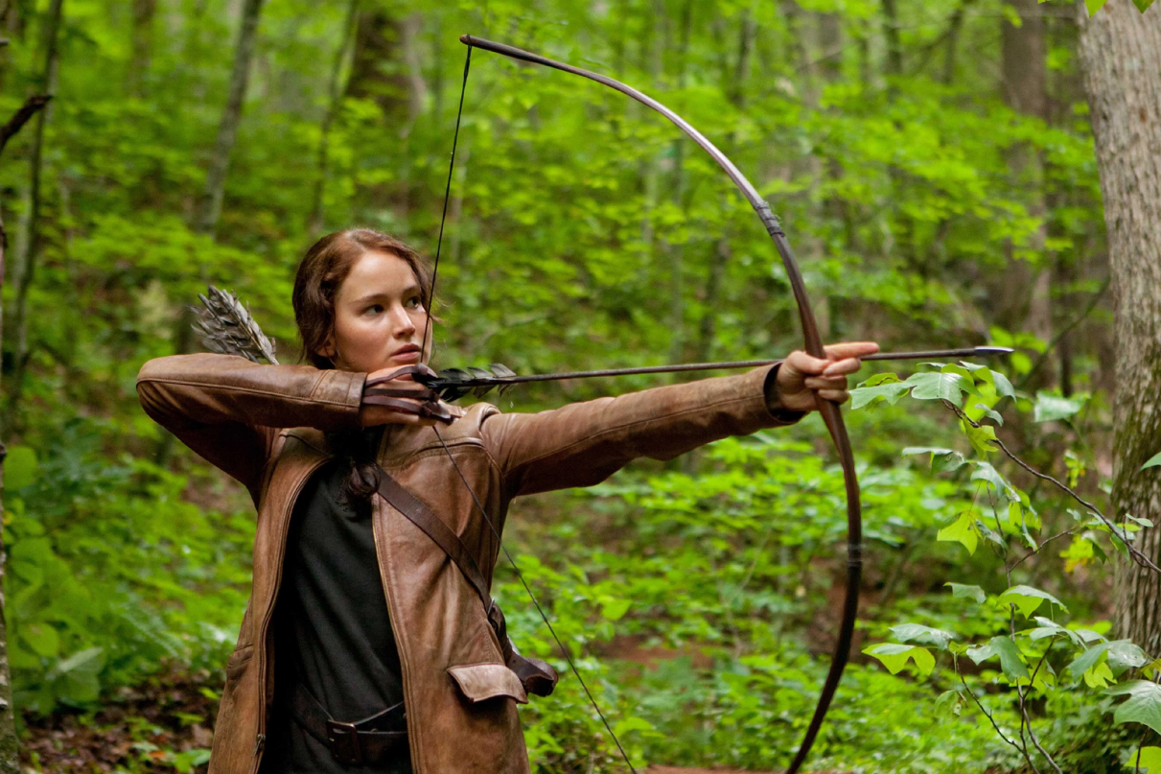
Black Widow
Actress: Angelina Jolie
Actress:
Scarlett Johansson
Actress: Jennifer Lawrence
Maleficent
Katniss Everdeen
Film: Maleficient
Film: The Hunger Game films
Film: Avengers
www.phuongnam.edu.vn

Slide 5



www.phuongnam.edu.vn

Slide 6
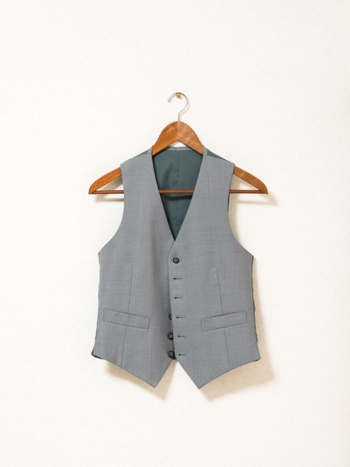
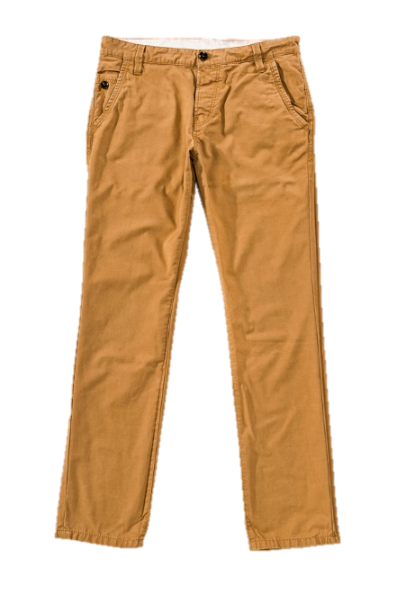
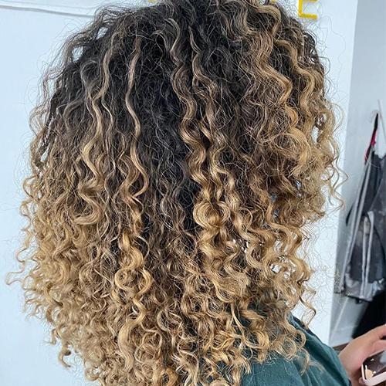
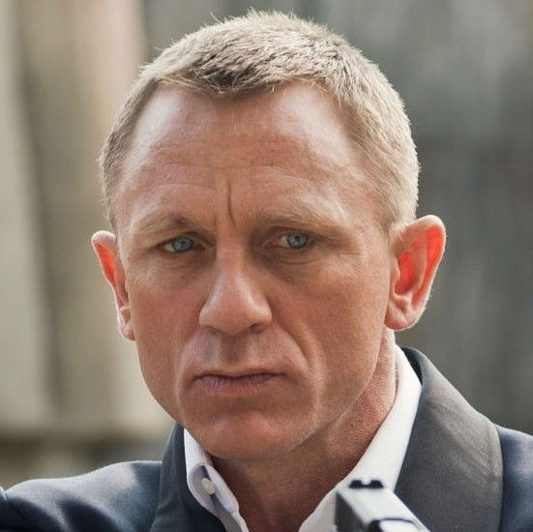
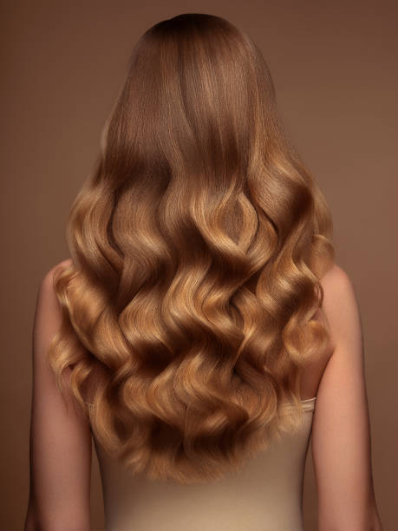
NEW VOCABULARY
1. Wavy (adj) /ˈweɪ.vi/ having a series of curves
2. Curly (adj) /ˈkɜː.li/ having curls or a curved shape
1.Wavy
2 curly
3 fair
4 trouser
5 waistcoat
3. Fair (adj) /feər/ (of hair) not bright or strong yellow
1.Wavy
2 curly
3 fair
4 trouser
5 waistcoat
4. Trousers (n) /ˈtraʊ.zəz/ a piece of clothing covering the lower part of the body from the waist to the foot
5. Waistcoat (n) /ˈweɪs.kəʊt/ a piece of clothing that covers the upper body but not the arms and usually has buttons down the front, worn over a shirt
www.phuongnam.edu.vn

Slide 7
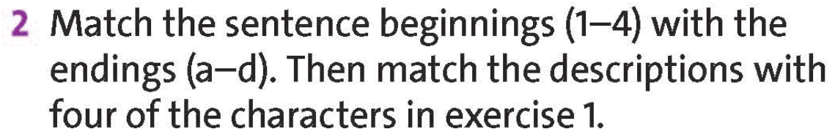
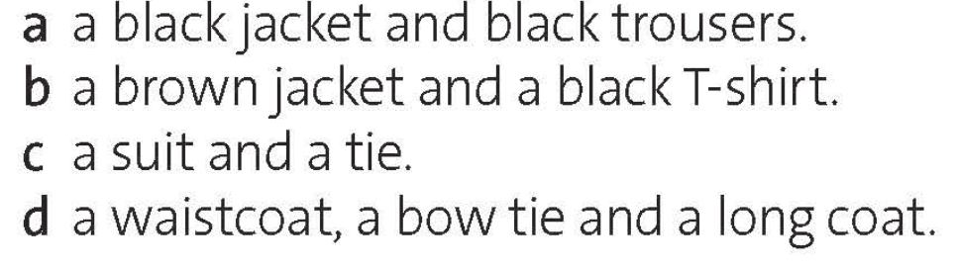
Katniss Everdeen
1 _________________ has got long brown hair. She’s wearing _____
b
a
2 _________________ has got long wavy hair. She’s wearing _____
Black Widow
3 _________________ has got short curly hair. He’s wearing _____
Newt Scamander
d
c
4 _________________ has got short fair hair. He’s wearing _____
James Bond
www.phuongnam.edu.vn

Slide 8

 | LENGTH | STYLE | COLOUR
He / She’s got | short | curly | dark | hair.
black
brown
fair
red
long
medium-length
straight
wavy
Check all
www.phuongnam.edu.vn

Slide 9
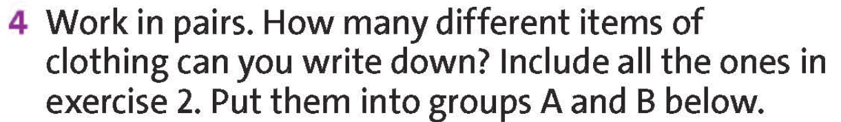
A. Top half | B. Bottom half
Jacket, shirt | Trousers, shoes,
coat
T-shirt
hat
jeans
socks
Check all
www.phuongnam.edu.vn

Slide 10
Examples:
Galadriel has got very long wavy fair hair. She’s wearing a white dress / blouse / shirt.
James Bond has got short straight fair / brown hair.
He’s wearing a light blue shirt, a dark blue jacket and trousers and a dark blue tie.
www.phuongnam.edu.vn

Slide 11

Pair - Work
www.phuongnam.edu.vn

Slide 12

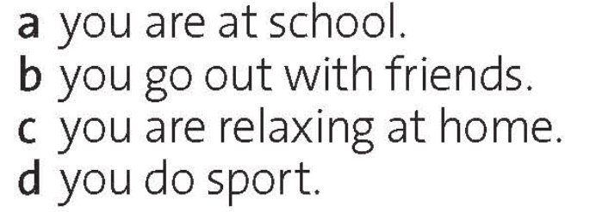
Example:
When I’m at school, I usually wear.. uniforms, white shirt, skirt, dark blue trousers, ao dai, etc….
..
www.phuongnam.edu.vn

Slide 13
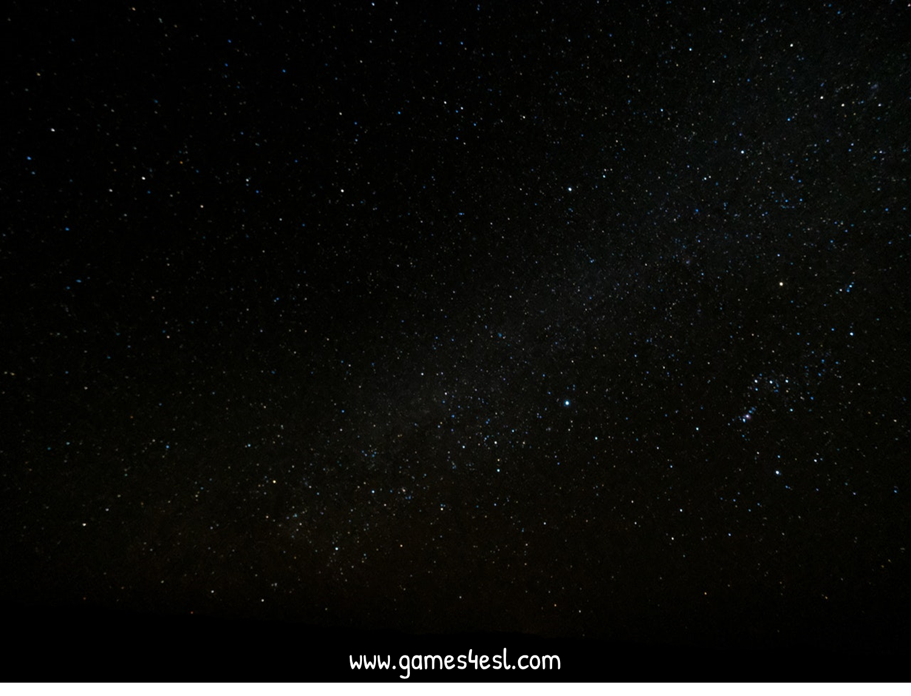

SPACE RACE
How to Play:
- Make 2 teams
- One team is the ‘Rocket’ and one team is the ‘Alien Ship’
- The teams take turns in choosing a number and then answering the question.
- After answering the question, click on the Rocket / Alien Ship and it will move.
- The first team to arrive at Mars is the winner.

Slide 14



SPACE RACE
Choose One:
Rocket Ship or Alien Ship?

Slide 15


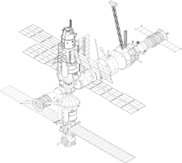










SPACE RACE
GO!
3
2
1
ALIEN SHIP
WINS!
ROCKET SHIP WINS!

Slide 16



SPACE RACE
1
2
3
4
5
6
7
8

Slide 17


1. When I’m at work, I usually wear….
Shirt, tie, skirt, belt, trousers, shoes, high heels,…

Slide 18
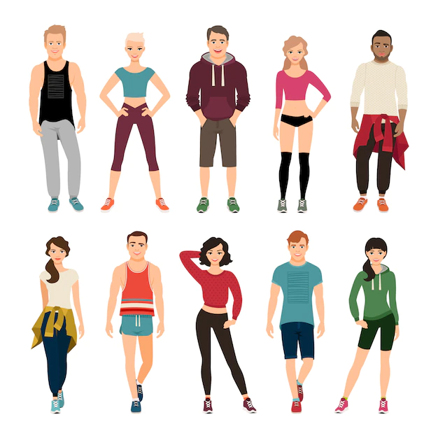
2. When I do sport, I usually wear….
T-shirt, running shoes, pants, hat, jacket,…

Slide 19
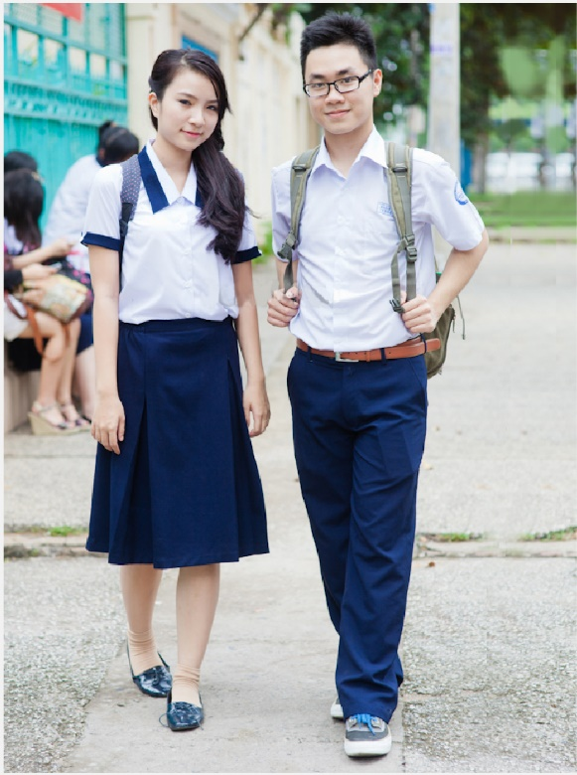
3. When I’m at school, I usually wear…
T-shirt, shirt, belt, trousers, shoes, suit, dress,…

Slide 20
4
LUCKY STAR

Slide 21
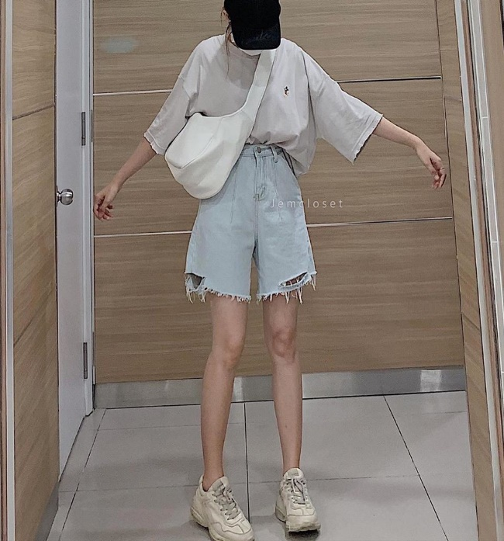
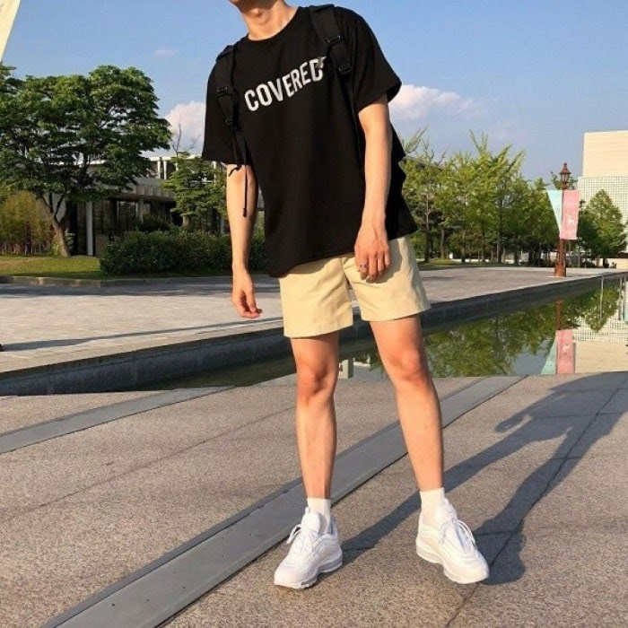
5. When I go out with friends, I usually wear….
T-shirt, short, jeans, sneakers, hat, jacket,…

Slide 22
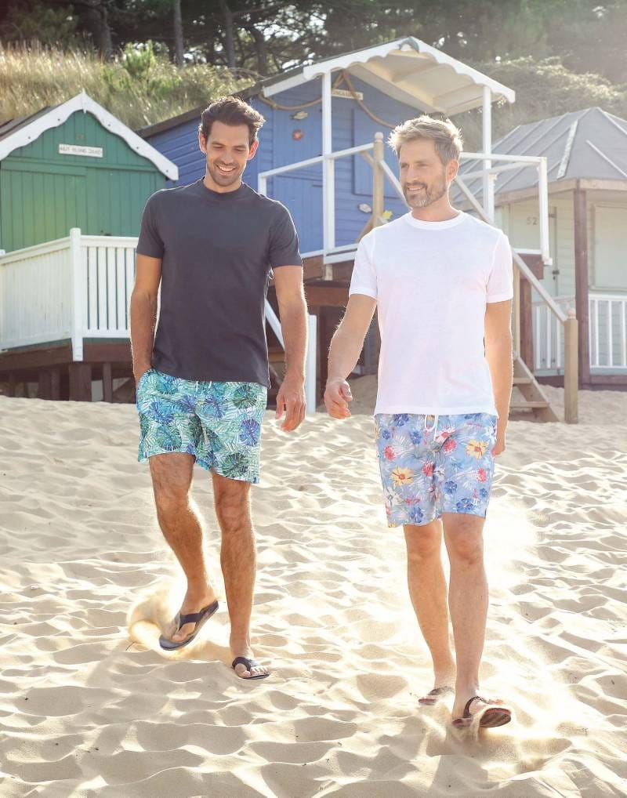
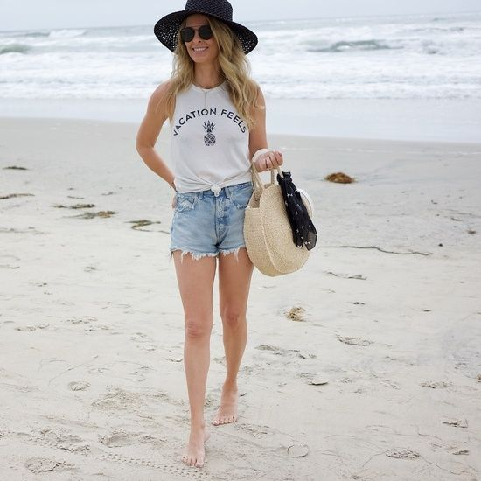
6. When I’m at the beach, I usually wear…
T-shirt, shirt, short, beach bathing suit, sandals, hat, sunglasses,…

Slide 23
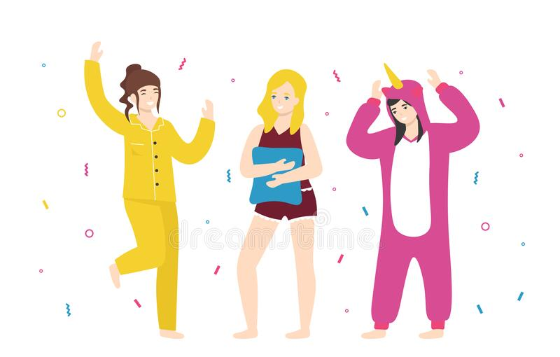
7. When I’m relaxing at home, I usually wear….
T-shirt, short, pajamas, crop top,….

Slide 24
8
LUCKY STAR

Slide 25
Homework
 Learn by heart all the new words.
 Prepare for next lesson – grammar: Articles
www.phuongnam.edu.vn

Slide 26

www.phuongnam.edu.vn

Slide 27



Thank you!
CTCP ĐẦU TƯ VÀ PHÁT TRIỂN GIÁO DỤC PHƯƠNG NAM

